Slide 1
KDD for choice of Application Server for NG CTP

Slide 2
Concern
Options | Jboss EAP | Pros | - Jboss EAP app server is the best choice for applications where developers need full access to the functionality that the Java EE provides and are happy with the default implementations of that functionality that ship with it. - Jboss EAP is Modular with trimming and slimming feature to pick and choose the required feature for your deployment.
 |  | Cons | - If one don’t need the full range of JEE features, then choosing App server will add a lot of complexity to deployment and resource overhead that will go unused = More development efforts for configuring Jboss EAP in Openshift 3.11 with Java 11. - Jboss EAP container will comparatively slower than Undertow in coming up live after restart - Though Slimming and Trimming can be applied to reduce size of Jboss EAP still it will be comparatively bigger than Undertow
 | Jboss Undertow | Pros | - Undertow is a Java servlet container and web server, because it doesn’t come with an implementation of the full JEE stack,it is significantly lighter weight out of the box. For developers who don’t need the full JEE stack that has two main advantages 1. Significantly less complexity and resource use. 2. Modularity. - Developers can choose the specific implementations they want to use to add extra functionality. there are many lightweight alternatives, including the Spring Framework and OpenEJB
 |  | Cons | - Undertow works great for smaller cluster but not recommended for larger clusters. The main drawback will be on performance. Replicated sessions involve copying of session data over to all the servers in the cluster. The more servers you have in the cluster, the additional overheads involved. - Zero development effort for configuring Undetow in Openshift 3.11 with Java 11.

Slide 3
Concern
Options | RedHat Jboss Web Server 5.3 (Tomcat 9.0) | Pros | - Jboss Webserver uses Tomcat which is a Java servlet container and web server, because it doesn’t come with an implementation of the full JEE stack,it is significantly lighter weight out of the box. For developers who don’t need the full JEE stack that has two main advantages 1. Significantly less complexity and resource use. 2. Modularity. Developers can choose the specific implementations they want to use to add extra functionality. there are many lightweight alternatives, including the Spring Framework and OpenEJB - RedHat supported
 |  | Cons | - Jboss Web Server will require standard image with Open JDK 11 - There will be one click yaml changes implementation required for Jboss Web Server as its new
 | Complex Java enterprise applications should choose Jboss EAP app server. We don’t need the full JEE stack are better off with Jboss Web Server which uses Tomcat the lightweight web container.

Slide 4
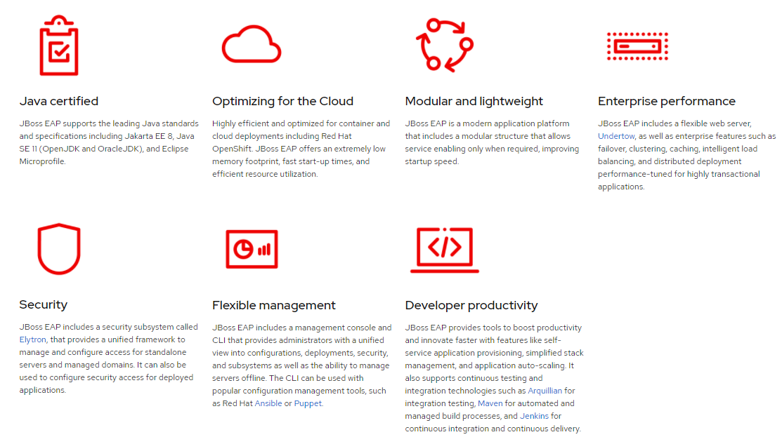
Jboss EAP

Slide 5
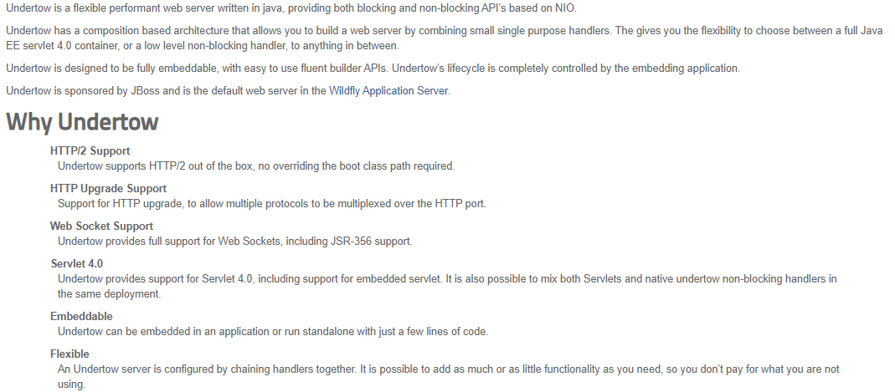
Jboss Undertow

Slide 6
Technology Comparison
Feature Supported | JBoss EAP | WebSphere | WebLogic | Apache TomEE+(Tommy) | Apache Tomcat | Undertow | Jboss Web Server
Java EE 8 Certified | Yes | Yes | Yes | Java EE 6 Certified | Not JEE compliance | Not JEE compliance | Not JEE compliance
Transaction Support -JTA | Yes | Yes | Yes | yes | No | No | No
EJBs | Yes | Yes | Yes | Yes | No | No | No
JMS | Yes | Yes | Yes | Yes | No | No | No
web services frameworks | Yes | Yes | Yes | Yes | Yes | Yes | Yes
Security Integration | Yes | Yes | Yes | Yes | Yes | Yes | Yes
JPA Integration | Yes | Yes | Yes | yes | yes | yes | yes
Transaction Aware Connection Pooling | Yes | Yes | Yes | Yes | yes | yes | yes
support for CDI Integration | Yes | Yes | Yes | Yes | Yes | Yes | Yes
Robust and reliable clustering | Yes | Yes | Yes | Uses Apache Tomcat | Yes | Yes | Yes
support for caching | Yes | Yes | Yes | yes | Yes | Yes | Yes
support for JCA | Yes | Yes | Yes | yes | No | No | No
ORM | Yes | Yes | Yes | yes | Yes | Yes | Yes

Slide 7
Feature Comparison
Feature Supported | JBoss EAP | WebSphere | WebLogic | Apache TomEE+(Tommy) | Apache Tomcat | Undertow | Jboss Web Server
Choice of Programming & Component Models | Yes | Yes | Yes | Yes | Yes | Yes | Yes
Remote Administration | Yes | Yes | Yes | Yes | Yes | Yes | Yes
Choice of OS & Database | Yes | Yes | Yes | Yes | Yes | Yes | Yes
Integrated Development Environment | Yes | Yes | Yes | Yes | Yes | Yes | Yes
24X7 Technical Support | Yes | Yes | Yes | No | No | No | Yes
Lightweight | Yes | Yes | Yes | Yes | yes | yes | yes
Easy to Install | Yes | Yes | Yes | Yes | Yes | Yes | Yes
Centralized Management | Yes | Yes | Yes | yes | Yes | Yes | Yes
Deployment Directories | Yes | Yes | Yes | yes | Yes | Yes | Yes
Security Domains | Yes | Yes | Yes | Extra Configurations | Extra Configurations | Extra Configurations | Extra Configurations
Security Auditing | Yes | Yes | Yes | Extra Configurations | Extra Configurations | Extra Configurations | Extra Configurations

Slide 8
Recommended Option, Rationale, References
Recommended Option:
RedHat Jboss Web Server 5.3 (Tomcat 9.0)
Rationale:
Complex Java enterprise applications should choose Jboss EAP app server. We don’t need the full JEE stack are better off with Jboss Web Server which uses Tomcat the lightweight web container for NGCTP.
References:

